Slide 1


Slide 2

Some of My Favorites:
Food: Pepperoni Pizza (extra crispy of course)
Color: Purple
Store: Amazon/ Kohls/ Target
Drink: Iced Tea/ Strawberry Acai Lemonade
Movie Type: Musicals
Holiday: Christmas Eve
My name is Jennifer Weber and I am so excited to be teaching 5th grade this year.
Fun Facts:
I have my Masters in Literacy and degrees in math and science
I previously taught 5th Grade, 4th Grade, and Middle School Science
I will watch Hallmark Christmas movies from October to January
I’ve known since the 1st grade that I wanted to become a teacher
I learn as much, if not more, from my students as they will learn from me

Slide 3

The best way to reach me is through email:
jweber@my.bdms.org
If you don’t hear from me within 24 hours during our Monday through Friday school week, please reach out again.
*I cannot guarantee that I will respond over the weekend or over holiday breaks.

Slide 4

Attendance / Dismissal
Homeroom: 7:20 - 7:45
  Homeroom is a vital part of the day in which students get to settle in, bond with their classmates, and start their work for the day.
First Class begins at 7:45
  From the moment students enter the room, we will be working.
Car Dismissal begins at 2:25
Bus Dismissal begins shortly after
**Please state any changes to dismissal on the School Dismissal Manager

Slide 5
Phone Policy
New York State has passed a law mandating a statewide "bell-to-bell" phone ban in all K-12 schools, taking effect in September 2025.
The ban restricts the use of Smartphones and internet-enabled personal devices (such as Smartwatches) during the school day.
The students turn in their electronic devices at the beginning of the day and retrieve them at dismissal time.

Slide 6
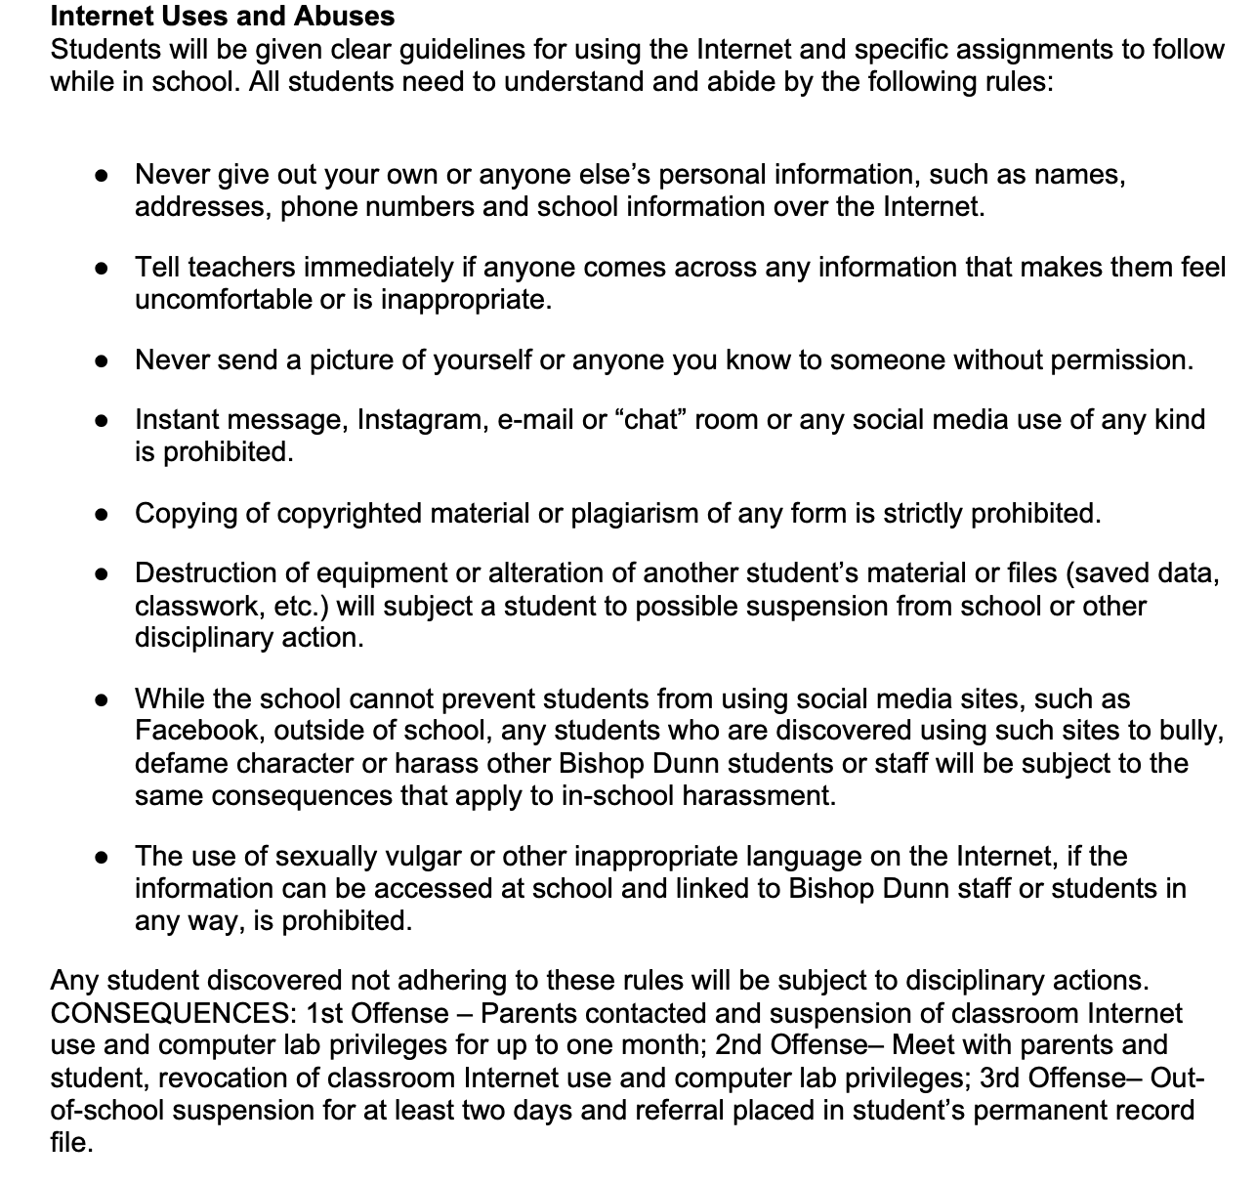
Technology

Slide 7
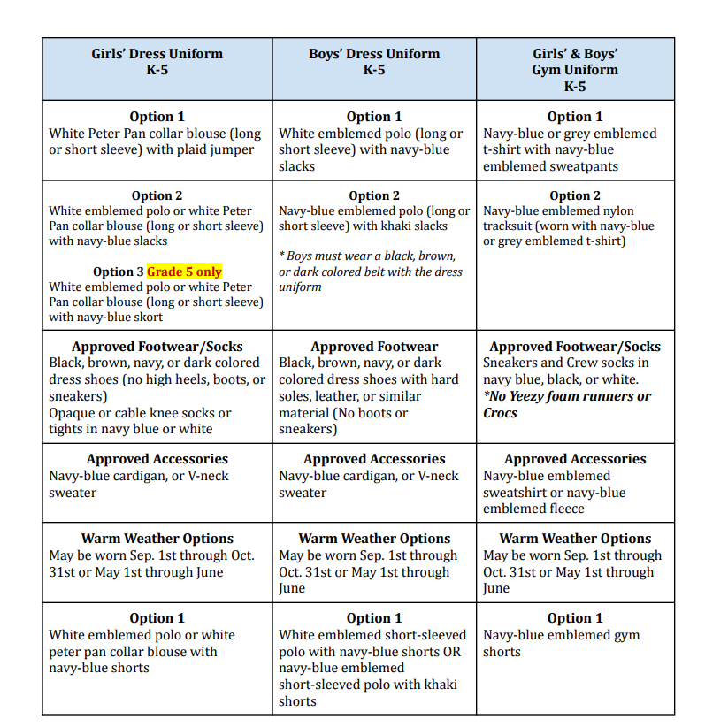
Uniforms

Slide 8
Google Classroom/ FACTS
We will be using Google Classroom in class as a way for students to easily access assignments. As the year progresses, students will also turn in certain assignments through Google Classroom.
Ms. Weber’s Fabulous Fifth Grade Class Google Classroom Code:
xo5r3eug
All assignments, grades, and overall averages can be found on the FACTS Parent Portal.
Consider allowing your fifth grader to navigate and monitor FACTS as a tool in becoming an autonomous and responsible learner.

Slide 9

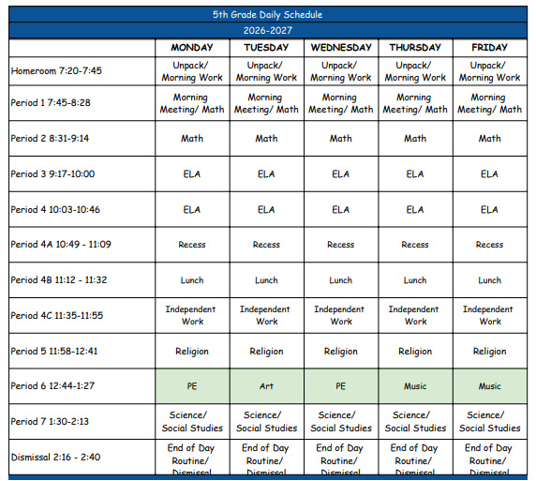

Slide 10
What Learning in Our Classroom Looks Like
Flexible Seating
Working together as a community of learners
Learning in different formats
Class management including the use of: earning BDMS KNIGHTS incentives, providing positive feedback to one another, reflecting on behavior choices

Slide 11

Students will have homework most nights. Homework will be written daily using their homework planner.
Often students will have homework associated with Math and/or Reading.
I won’t assign homework that should take longer than 40 minutes to complete.
  If your child is struggling with an assignment, please write me a note or send me an email and I will work with them the following day.

Slide 12
Extra Help
I will be offering after school help on Thursdays from 3:00 to 4:00.
If you are interested in your child staying, please let me know through email at least 24 hours in advance. Once I confirm that your child may attend our class session, please update your child’s dismissal information in SDM.
Please know that this help is open to everyone in the classroom. It is not one on one help but extra support for key concepts that students may be struggling with in class.

Slide 13
Upcoming Events This Year
October (Date TBD) Purple Heart Museum - $25 per student
SOLDIERS ACROSS TIME is an interactive program offered at the National Purple Heart Hall of Honor that engages students in discovering the nearly 160 years of history we have collected about Purple Heart recipients.
We will definitely go on at least one more field trip (potentially 2 more). Information will be sent out as soon as arrangements have been finalized.

Slide 14
Upcoming Events This Year
Safe Environment Lesson in September
November (date TBD) -
Veteran’s Brunch
December 16th -
Christmas Pageant (Pre-K - 5th) 12:30 pm
June 15th -
5th Grade Moving Up Ceremony 9 am

Slide 15

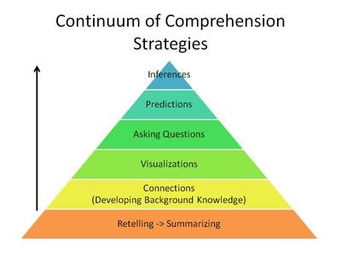
Key Concepts: Reading

Slide 16
Key Concepts: Writing
Grammar:
  Parts of speech, detailed paragraph writing, referring to resources
Vocabulary
  A new unit every 2 weeks
Writing Process:
  Brainstorming
  Drafting
  Revising
  Editing
  Publish

Slide 17
Key Concepts: Math
Place value understanding for multi-digit decimal numbers
Use place value understanding and properties of operations to perform multi-digit operations
Use the four operations with decimal numbers to solve problems
Gain familiarity with GCF and LCM
Fraction equivalence and simplification
Solve problems involving measurement and conversion of measurements from a larger unit to a smaller unit
Understanding how to find the volume of an object and the area of complex models

Slide 18
Key Concepts: Science
The performance expectations in fifth grade help students formulate answers to questions related to:
Properties of Matter
Energy in Chemical Processes and Everyday Life
Organization for Matter and Energy Flow in Organisms
Cycles of Matter and Energy Transfer in Ecosystems
Earth and the Solar System
The Roles of Water in Earth’s Surface Processes

Slide 19
Key Concepts: Social Studies
Branches of Government
Colonial and Revolutionary Period
Creation of the Constitution
In Search of Freedom and a Call for Change
Westward Movement and Industrialization
The Civil War
Immigration and Migration from the Early 1800s to the Present

Slide 20
Key Concepts: Religion
The overall theme this year is understanding, as God’s people, we are called to live as Jesus did, choosing a life of love, characterized by obedience to God and service to others.
This year we study the Holy Days of Obligation, the Mysteries of the Rosary, and the Seven Sacraments.
Additionally, we will review the parts and responses of mass.

Slide 21



